Slide 1
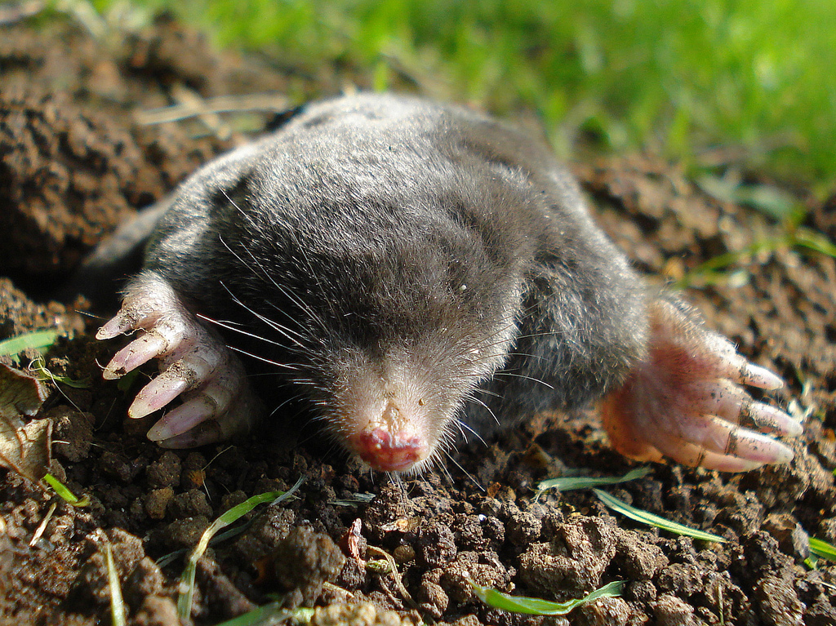
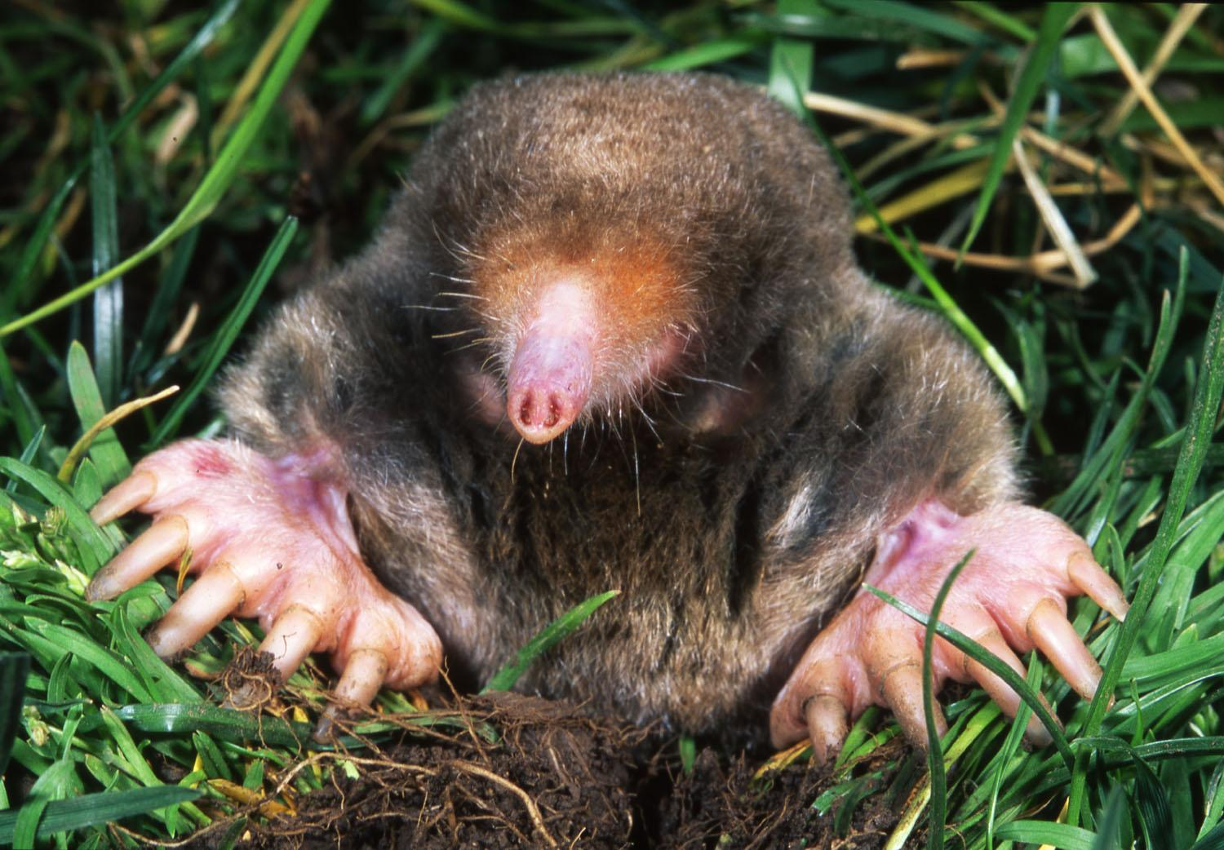
Molar Mass and the Mole
Ms. Chang

Slide 2
What is a mole?

Slide 3
The Mole
Mole is a form of measurement
Similar to:
Dozen
Pair
It is used to count the number of atoms in a substance

Slide 4
Calculating Moles
One mole = 6.02 x 10²³ atoms
JUST LIKE….
One dozen = 12 cookies

Slide 5
How many cookies are in 5 dozen?

Slide 6
How many cookies are in 5 dozen?
12 x 5 = 60

Slide 7
How many cookies are in 5 dozen?
atoms

Slide 8
How many cookies are in 5 dozen?
atoms
12 x 5 = 60

Slide 9
How many cookies are in 5 dozen?
atoms
moles

Slide 10
How many cookies are in 5 dozen?
atoms
moles
5 x (6.02 x 10²³) =

Slide 11
Conversion Factor or Ratio
12 cookies
1 dozen
OR
1 dozen
12 cookies
6.02 x 10²³ atoms
1 mole
OR
1 mole
6.02 x 10²³ atoms
=

Slide 12
Moles ⇿ Atoms
If atoms is given and you want moles....
___ atoms x 1 mole =
6.02 x 10²³ atoms
If moles is given and you want atoms….
___ moles x 6.02 x 10²³ atoms =
1 mole

Slide 13
Moles ⇿ Atoms
If atoms is given and you want moles....
___ atoms x 1 mole = _______ moles
6.02 x 10²³ atoms
If moles is given and you want atoms….
___ moles x 6.02 x 10²³ atoms = ____ atoms
1 mole

Slide 14
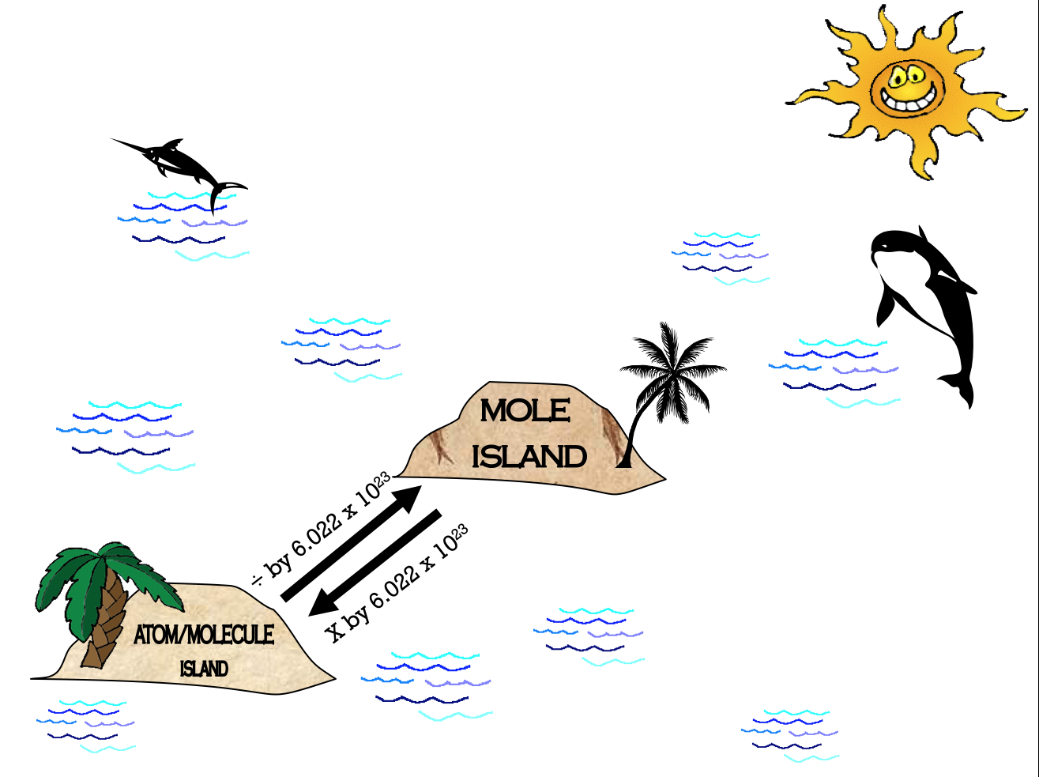

Slide 15
For example...
How many moles of Mg are in 1.25 x 10²³ atoms?
Need to go from atoms ➝ moles

Slide 16
For example...
How many moles of Mg are in 1.25 x 10²³ atoms?

Slide 17
For example...
How many moles of Mg are in 1.25 x 10²³ atoms?

Slide 18
For example...
How many moles of Mg are in 1.25 x 10²³ atoms?
0.208 moles

Slide 19
Example 2...
How many atoms of C are in 2.0 moles?
Need to go from moles ➝ atoms

Slide 20
Example 2...
How many atoms of C are in 2.0 moles?

Slide 21
Example 2...
How many atoms of C are in 2.0 moles?

Slide 22
Example 2...
How many atoms of C are in 2.0 moles?
1.2 x 10²⁴ atoms

Slide 23
Assignment
Submit a picture of your completed notes on assignment titled “The Mole Lecture and Notes”
Complete the first half of “Conversion Practice Problems” worksheet with WORK SHOWN
Highlight or underline your answers
Due 2/13 on Google Classroom

Slide 24
What about mass?

Slide 25
What is molar mass?
The mass in grams of 1 mole of the substance

Slide 26
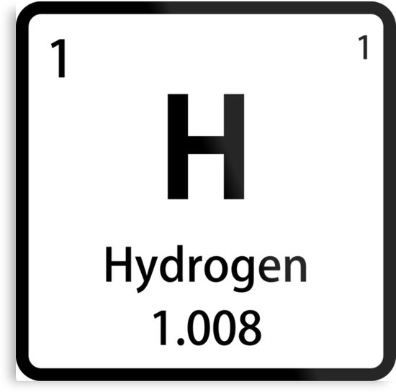
How do I find molar mass?
Look on the periodic table
1.008 g/mole

Slide 27
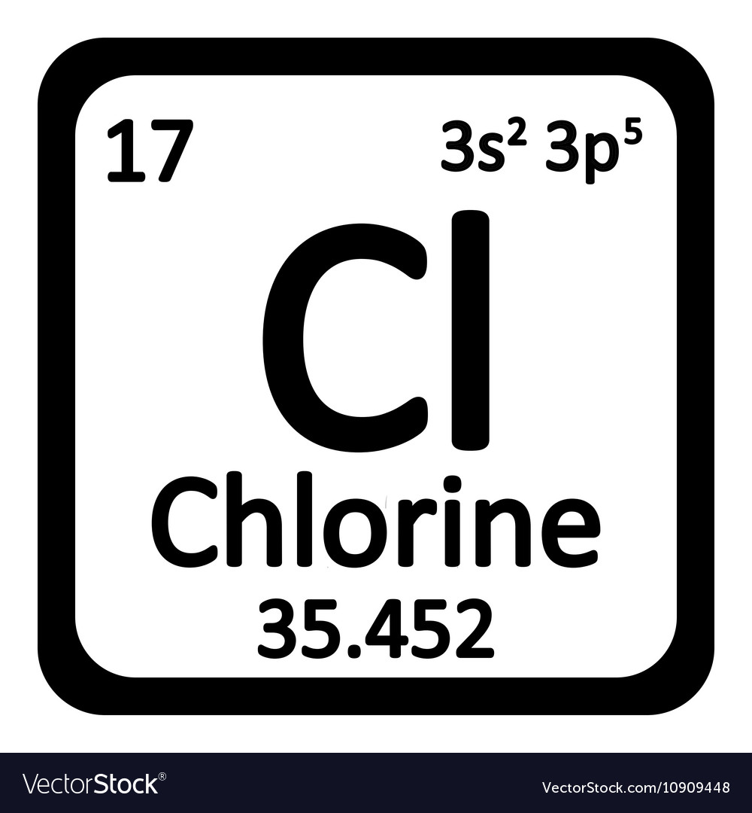
Calculate the molar mass of HCl

Slide 28
Calculate the molar mass of HCl
36.46 g/mole

Slide 29
Moles ⇿ Mass (g)
If grams is given and you want moles....
___ grams x 1 mole =
Molar mass (g)
If moles is given and you want grams….
___ moles x molar mass (g) =
1 mole

Slide 30
Moles ⇿ Mass (g)
If grams is given and you want moles....
___ grams x 1 mole = ______ moles
Molar mass (g)
If moles is given and you want grams….
___ moles x molar mass (g) = ______ grams
1 mole

Slide 31
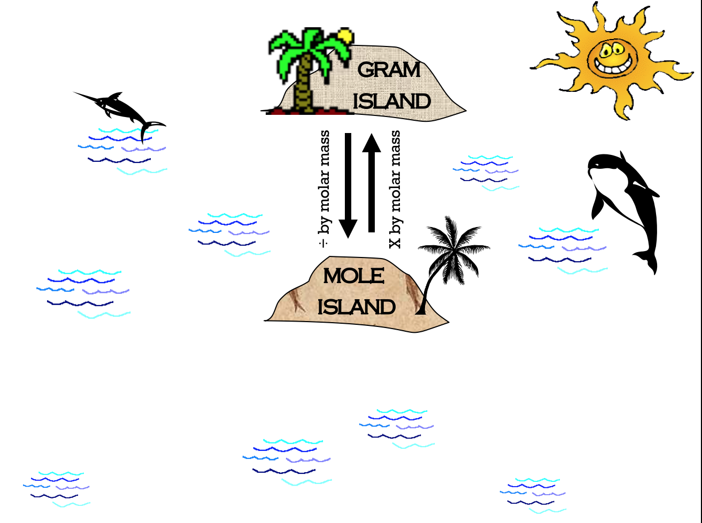

Slide 32
For example...
How many moles are in 92.2 grams of Fe?
Need to go from grams ➝ moles

Slide 33
For example...
How many moles are in 92.2 grams of Fe?
Molar mass of Fe = 55.85 g/mole

Slide 34
For example...
How many moles are in 92.2 grams of Fe?

Slide 35
Example 2...
What is the mass of 9.45 moles of HCl?
Need to go from moles ➝ grams

Slide 36
Example 2...
What is the mass of 9.45 moles of HCl?
Molar mass of HCl = 36.46 g/mole

Slide 37
Example 2...
What is the mass of 9.45 moles of HCl?
9.45 mol HCl x 36.46g HCl =
1 mol HCl

Slide 38
Example 2...
What is the mass of 9.45 moles of HCl?
9.45 mol HCl x 36.46 g HCl = 344.55 g HCl 1 mol HCl

Slide 39
Assignment
Submit a picture of your completed notes on assignment titled “The Mole Lecture and Notes”
Complete the “Conversion Practice Problems” worksheet with WORK SHOWN
Highlight or underline your answers
Take a picture of your completed worksheet and submit on Google Classroom assignment titled “Mole Conversion Practice”
Due 2/13 on Google Classroom

